Slide 1


MAJOR PROJECT
HOME RENTAL
Supervisor: Dr. Le Thi Ngoc Tho
Member:
Tran Minh Son - 1911065933
Bui Tuan Long Huan - 1911252088
Class: 19DTHQA2

Slide 2


TABLE OF CONTENTS
INTRODUCTION
ANALYSIS AND DESIGN
TOOLS AND DEVELOPMENT ENVIRONMENT
DEMO
CONCLUSIONS AND FUTURE WORK

Slide 3



INTRODUCTION:
MOTIVATION
With the rise of IT, online business and shopping have become trends. To meet the growing demand for home rentals, especially among tourists, we've developed the "Home Rental Management System" to simplify the rental process for customers and homeowners.

Slide 4
INTRODUCTION:
PROJECT FUNCTIONS
TENANT | ADMIN
- Register, log in to the system. - Filter properties by category. - Search properties by personal criteria. - Add to favorites. - View host information. - Contact host. - Book a room. - Pay online. - View booking history. | - Manage properties on the system. - Manage accounts on the system. - Manage transactions.

Slide 5

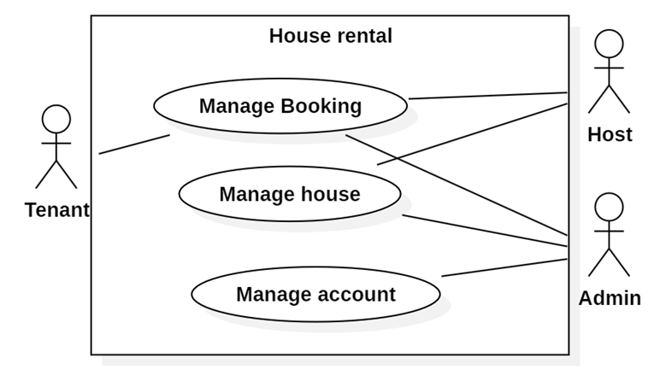
ANALYSIS AND DESIGN
USE CASE

Slide 6
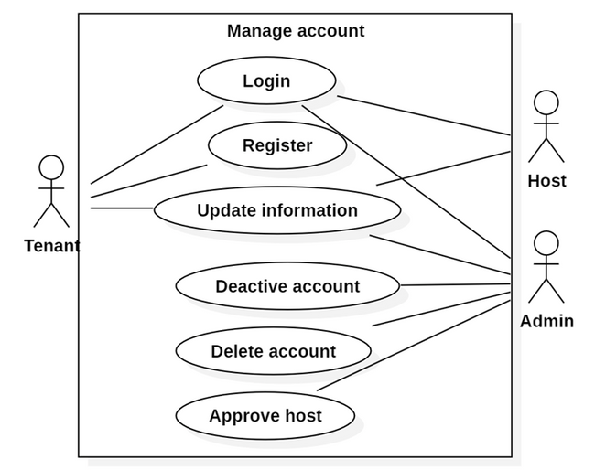
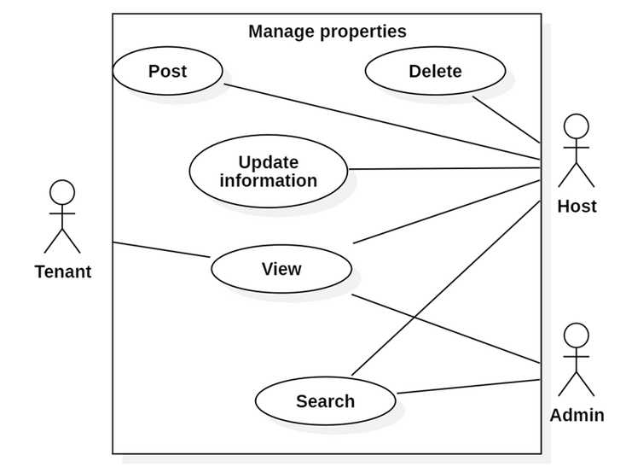
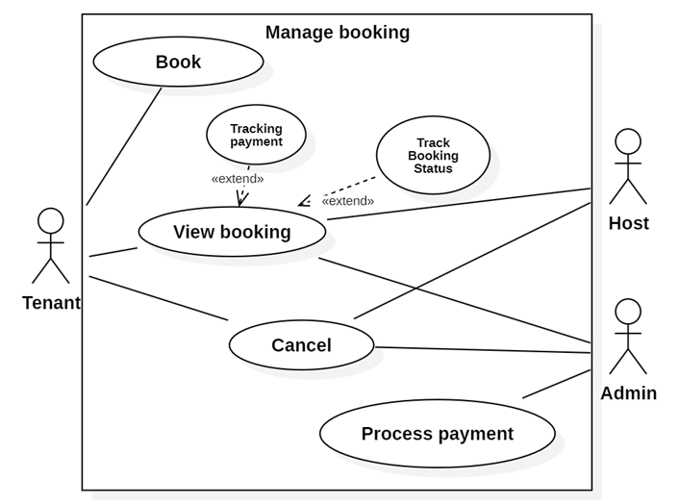
ANALYSIS AND DESIGN
USE CASE

Slide 7
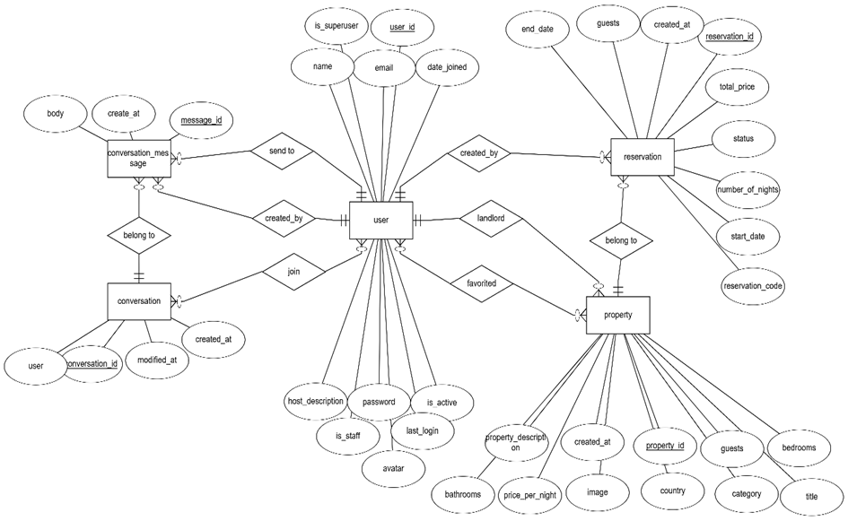
ANALYSIS AND DESIGN: ER DIAGRAM

Slide 8
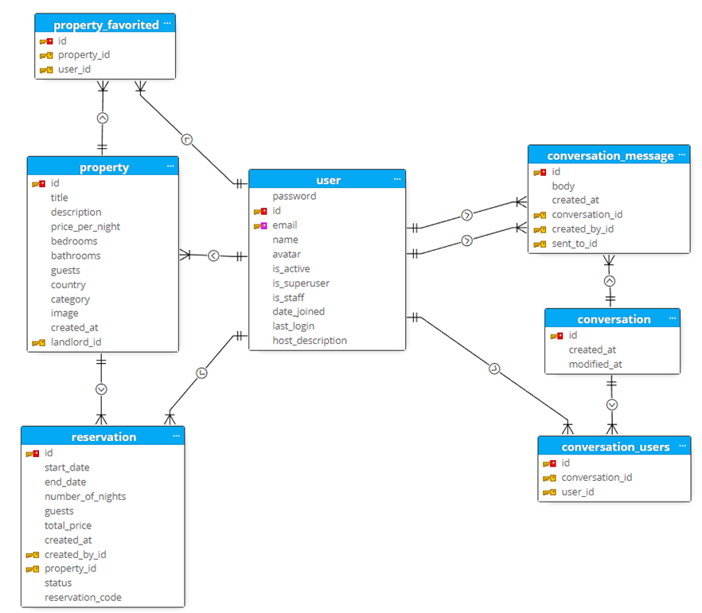
ANALYSIS AND DESIGN: DATABASE

Slide 9








TOOLS AND DEVELOPMENT ENVIRONMENT

Slide 10
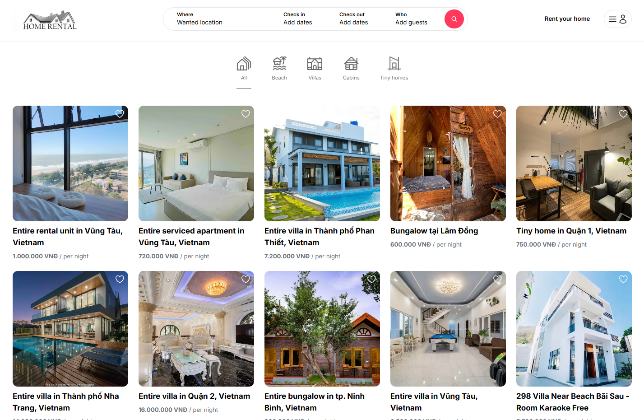
TENANT:
HOME PAGE
SEARCH
PROPERTY
LOGIN
SIGN UP
FAVORITES
LANDLORDS
CHAT
RESERVATION
ADMIN/HOST:
LOGIN
HOME PAGE
MANAGE USER
ADD/UPDATE USER
MANAGE PROPERTY
ADD/UPDATE PROPERTY
MANAGE RESERVATION
DEMO

Slide 11
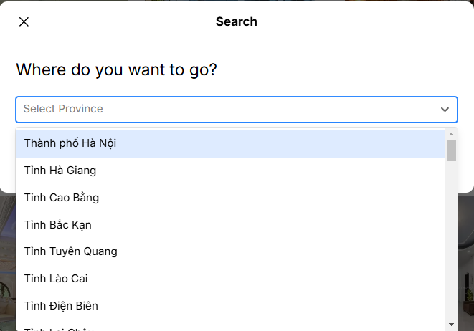
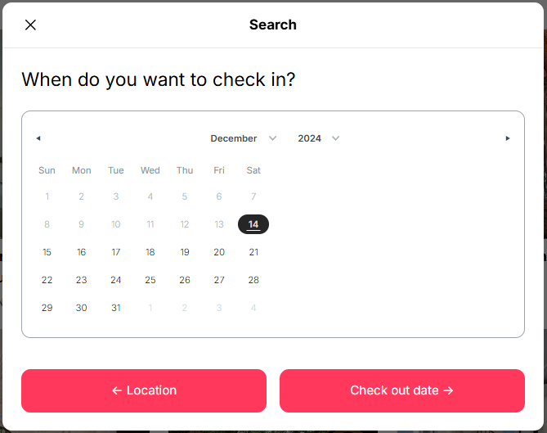
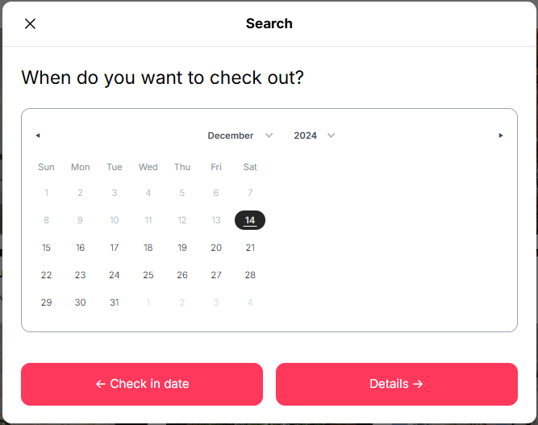
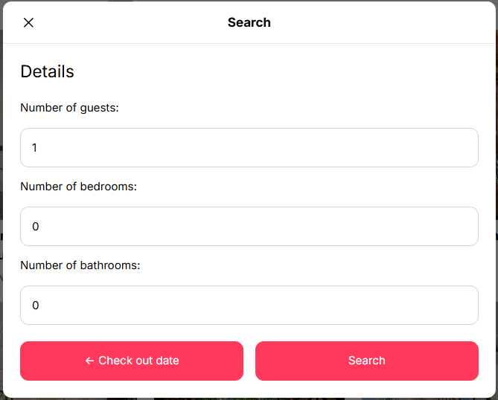
TENANT:
HOME PAGE
SEARCH
PROPERTY
LOGIN
SIGN UP
FAVORITES
LANDLORDS
CHAT
RESERVATION
ADMIN/HOST:
LOGIN
HOME PAGE
MANAGE USER
ADD/UPDATE USER
MANAGE PROPERTY
ADD/UPDATE PROPERTY
MANAGE RESERVATION
DEMO

Slide 12
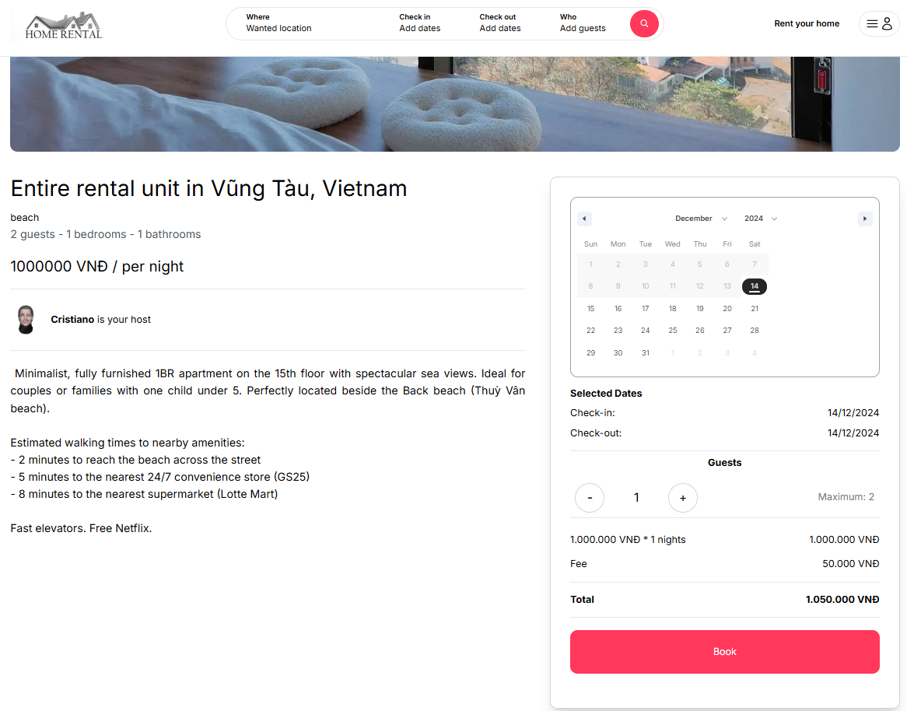
TENANT:
HOME PAGE
SEARCH
PROPERTY
LOGIN
SIGN UP
FAVORITES
LANDLORDS
CHAT
RESERVATION
ADMIN/HOST:
LOGIN
HOME PAGE
MANAGE USER
ADD/UPDATE USER
MANAGE PROPERTY
ADD/UPDATE PROPERTY
MANAGE RESERVATION
DEMO

Slide 13
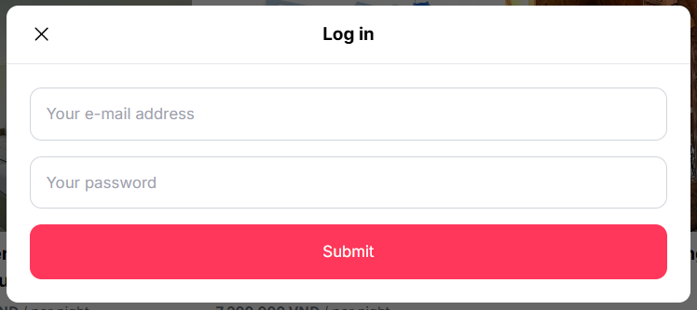
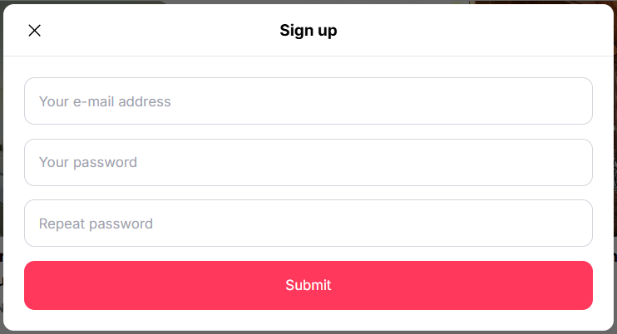
TENANT:
HOME PAGE
SEARCH
PROPERTY
LOGIN
SIGN UP
FAVORITES
LANDLORDS
CHAT
RESERVATION
ADMIN/HOST:
LOGIN
HOME PAGE
MANAGE USER
ADD/UPDATE USER
MANAGE PROPERTY
ADD/UPDATE PROPERTY
MANAGE RESERVATION
DEMO

Slide 14
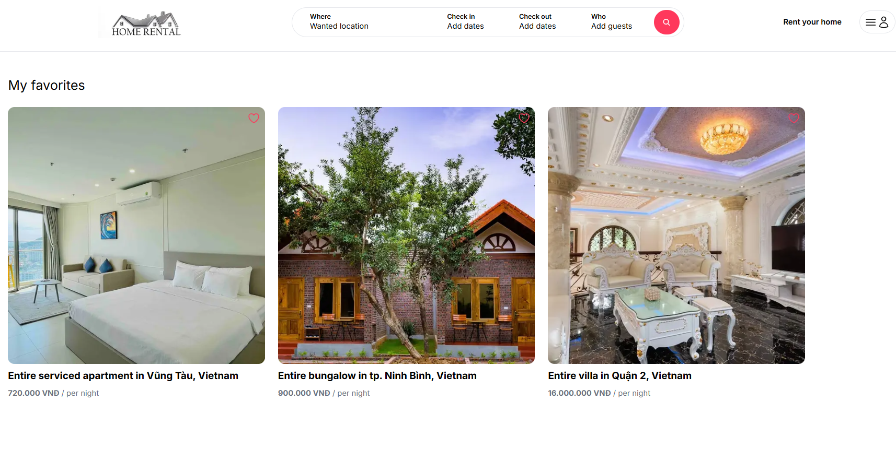
TENANT:
HOME PAGE
SEARCH
PROPERTY
LOGIN
SIGN UP
FAVORITES
LANDLORDS
CHAT
RESERVATION
ADMIN/HOST:
LOGIN
HOME PAGE
MANAGE USER
ADD/UPDATE USER
MANAGE PROPERTY
ADD/UPDATE PROPERTY
MANAGE RESERVATION
DEMO

Slide 15
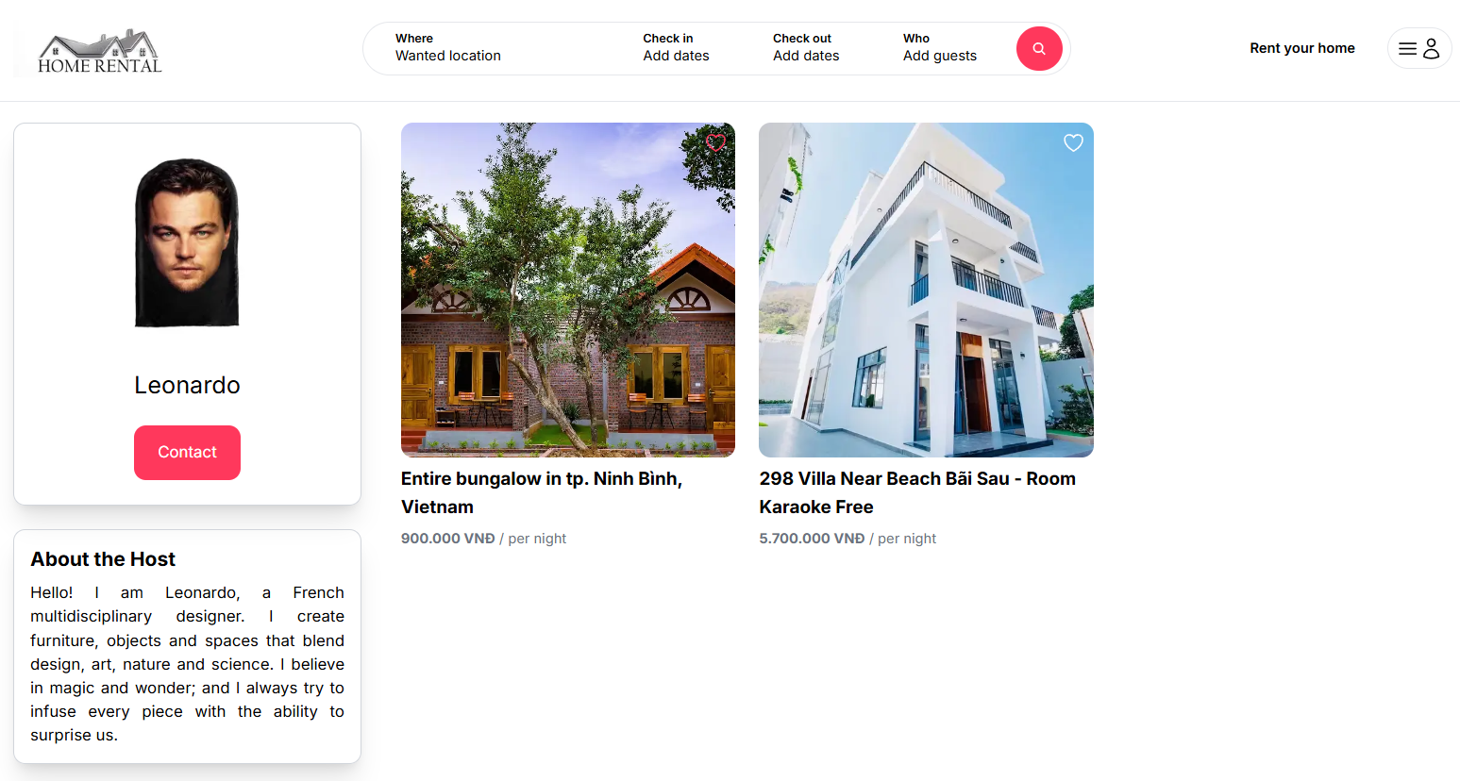
TENANT:
HOME PAGE
SEARCH
PROPERTY
LOGIN
SIGN UP
FAVORITES
LANDLORDS
CHAT
RESERVATION
ADMIN/HOST:
LOGIN
HOME PAGE
MANAGE USER
ADD/UPDATE USER
MANAGE PROPERTY
ADD/UPDATE PROPERTY
MANAGE RESERVATION
DEMO

Slide 16
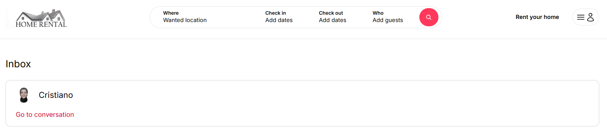
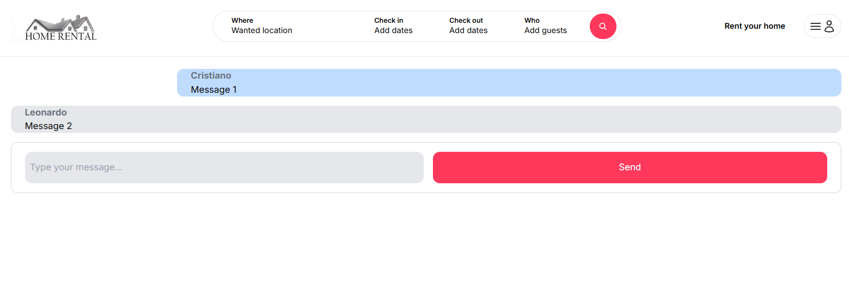
TENANT:
HOME PAGE
SEARCH
PROPERTY
LOGIN
SIGN UP
FAVORITES
LANDLORDS
CHAT
RESERVATION
ADMIN/HOST:
LOGIN
HOME PAGE
MANAGE USER
ADD/UPDATE USER
MANAGE PROPERTY
ADD/UPDATE PROPERTY
MANAGE RESERVATION
DEMO

Slide 17
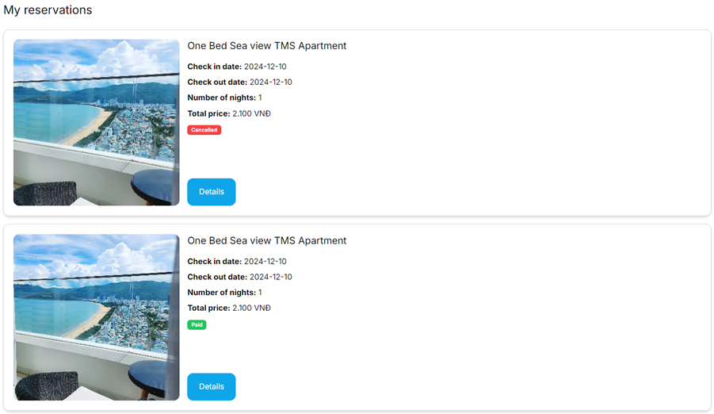
TENANT:
HOME PAGE
SEARCH
PROPERTY
LOGIN
SIGN UP
FAVORITES
LANDLORDS
CHAT
RESERVATION
ADMIN/HOST:
LOGIN
HOME PAGE
MANAGE USER
ADD/UPDATE USER
MANAGE PROPERTY
ADD/UPDATE PROPERTY
MANAGE RESERVATION
DEMO

Slide 18
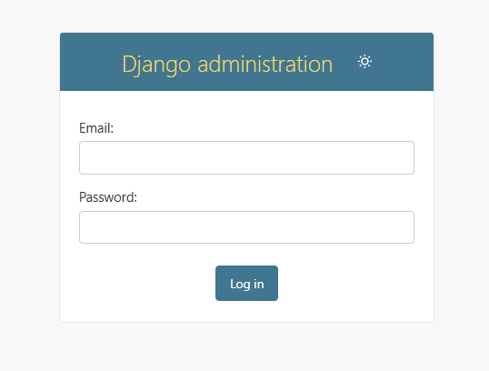
TENANT:
HOME PAGE
SEARCH
PROPERTY
LOGIN
SIGN UP
FAVORITES
LANDLORDS
CHAT
RESERVATION
ADMIN/HOST:
LOGIN
HOME PAGE
MANAGE USER
ADD/UPDATE USER
MANAGE PROPERTY
ADD/UPDATE PROPERTY
MANAGE RESERVATION
DEMO

Slide 19
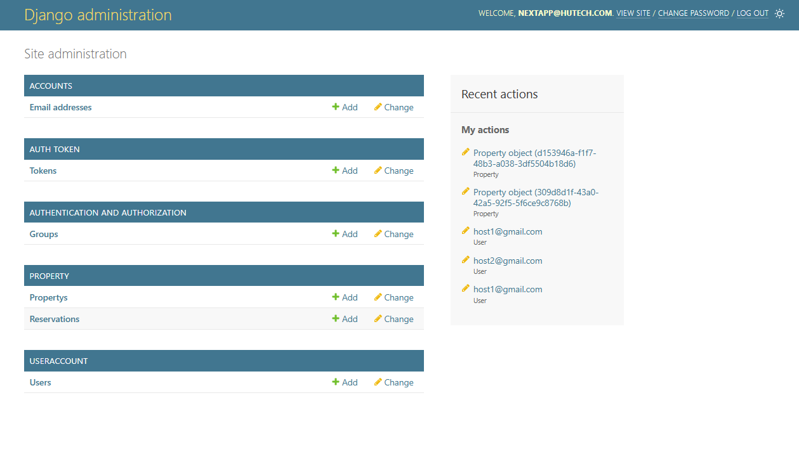
TENANT:
HOME PAGE
SEARCH
PROPERTY
LOGIN
SIGN UP
FAVORITES
LANDLORDS
CHAT
RESERVATION
ADMIN/HOST:
LOGIN
HOME PAGE
MANAGE USER
ADD/UPDATE USER
MANAGE PROPERTY
ADD/UPDATE PROPERTY
MANAGE RESERVATION
DEMO

Slide 20
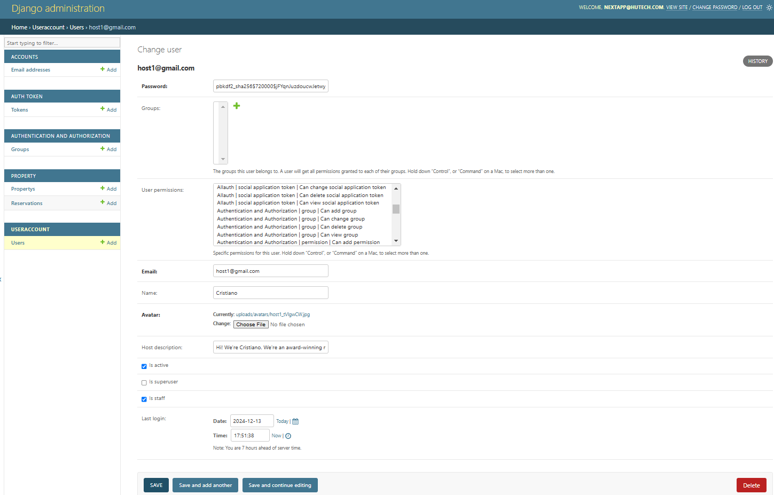
TENANT:
HOME PAGE
SEARCH
PROPERTY
LOGIN
SIGN UP
FAVORITES
LANDLORDS
CHAT
RESERVATION
ADMIN/HOST:
LOGIN
HOME PAGE
ADD/UPDATE USER
ADD/UPDATE PROPERTY
MANAGE RESERVATION
DEMO

Slide 21
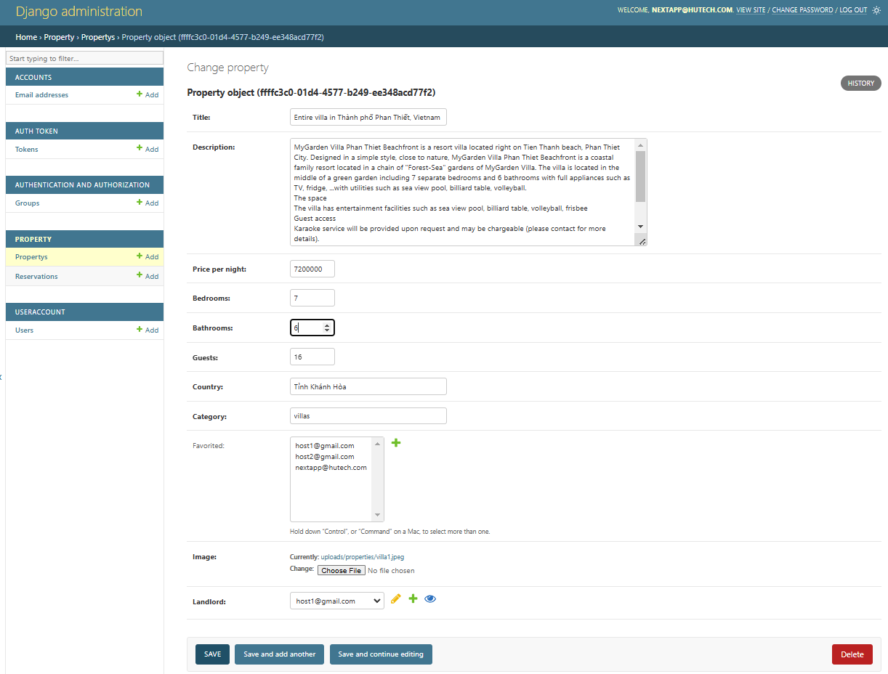
TENANT:
HOME PAGE
SEARCH
PROPERTY
LOGIN
SIGN UP
FAVORITES
LANDLORDS
CHAT
RESERVATION
ADMIN/HOST:
LOGIN
HOME PAGE
ADD/UPDATE USER
ADD/UPDATE PROPERTY
MANAGE RESERVATION
DEMO

Slide 22
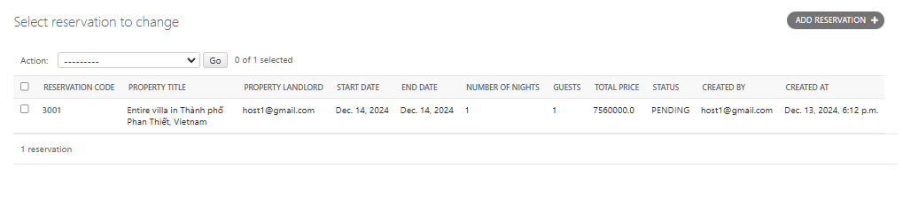
TENANT:
HOME PAGE
SEARCH
PROPERTY
LOGIN
SIGN UP
FAVORITES
LANDLORDS
CHAT
RESERVATION
ADMIN/HOST:
LOGIN
HOME PAGE
ADD/UPDATE USER
ADD/UPDATE PROPERTY
MANAGE RESERVATION
DEMO

Slide 23
CONCLUSIONS AND FUTURE WORK
Completed: System analysis and design System has full proposed functions Simple, easy-to-use interface Incomplete Separate management interface for host
Mobile development: create mobile version of application to optimize experience and performance. User reviews: develop review function to help users share their experiences with everyone

Slide 24
THANK YOU

